Slide 1
American History
Talk 3: From Settlement to Societies (1600 -1700)

Slide 2
This talk: Settlements to Societies
1
Settlement and survival 1607-1660’s
Settlement of Jamestown Viriginia
Mayflower and Puritan New England
----------------------------------Break-----------------------------------
Survival to society1670’s-1700
The Pennsylvania Experiment
Rebellion and aristocrats Virginia
Puritan life intolerance, witches, ad order

Slide 3
North American situation 1600
100 years of exploration completed of coast and interior
Spain focused on Empire in Central and South America
One permanent settlement in North America, St Augustine Florida with probably 50 soldiers trying to stay alive
Attempts to find North West Passage by French and English have failed
England no longer at risk of invasion, Ireland pacified, James V1 of Scotland about to become king and ambitious to exploit New World

Slide 4
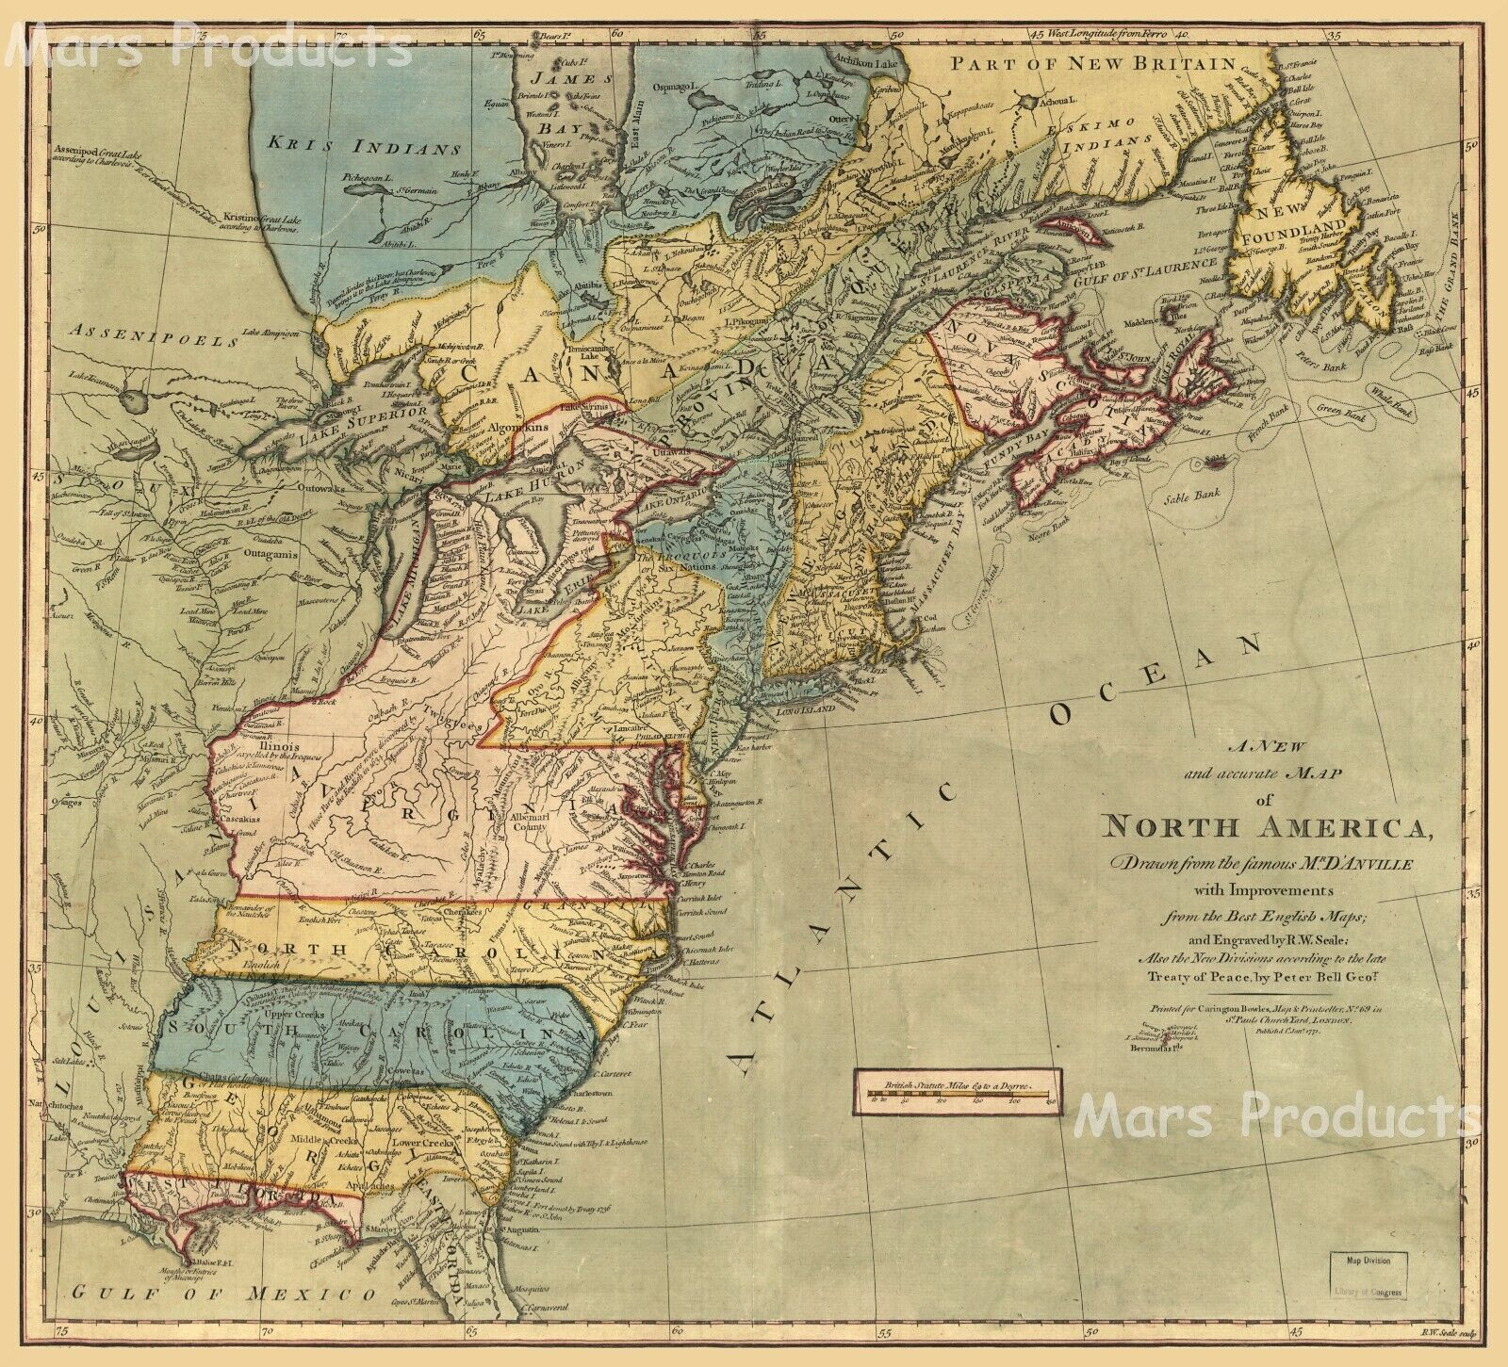
Three colonies…no one “America” story
2
Pennsylvania
1670
New England
1620
Jamestown…Virginia
1608

Slide 5
Jamestown Virginia
3
1606 King James 1 grants charter to Virginia Company of London
‘Virginia’ anywhere north of Spanish colonies
Remit: Profit for Virginia company…preferably gold but anything will do…
Captain Newport and 3 ships with 105 colonists leave for America…all men and ‘Adventurers’
Captain Smith’s mutiny…the sealed orders
Arrive at Virginia May 1607
Notes:
1608: Jamestown Virginia settlement
100 men and boys arrived 1607, too many ‘ gentlemen”, near starvation
‘Governing Council’ names in metal box to be opened en route
Among them Captain John Smith (mercenary, Fought with Dutch vs Spain, then Holy Roman Empire vs Ottomans, captured sold into slavery, escaped by killing owner, went to Russia, Poland, England coat of arms engraved with three heads (representing three Turkish officers he had killed) and the motto Vincere est Vivere, Latin for “to conquer is to live.”
Run out of food, lots of gentlemen few willing to actually farm. Then in April, they experienced an infestation of rats, along with dampness which destroyed all their stored corn. They needed food badly and Smith sent a large group of settlers to fish and others to gather shellfish downriver. They came back without food , given scraps by Indians. Smith ordered them to trade their guns and tools for fruit from the Indians and everyone to work or be banished from the fort.^{[20]}
Skirmishes with Indians. Smith captured and ‘adopted’ (JS though love of Pocohantas.. @peace of Pocohntas till 1620) “
Introduces no work work no food “There was no talk, no hope, no work but dig gold, wash gold, refine gold, load gold --- such a bruit of GOLD that one mad fellow desired to be buried in the sands, lest they should by their art make gold of his bones!"
Reinforced each year, including 90 women 1609
Fire, extreme cold, Powahattan sends food
Hurt by gunpowder ,Pocohanos marries Jone Rolfe, returns to England celebrity, dies of typhus. JS retires to country, writes memories .
More ships arrive 1609-10, “Starving Time” population of James reduced from 500 to 60 Cannibalism….more ships arrive tobacco 1612 and profitability
First Africans arrive 1619 50 …. ‘indentured servants’….perpetually
3,000 settlers by 1620

Slide 6
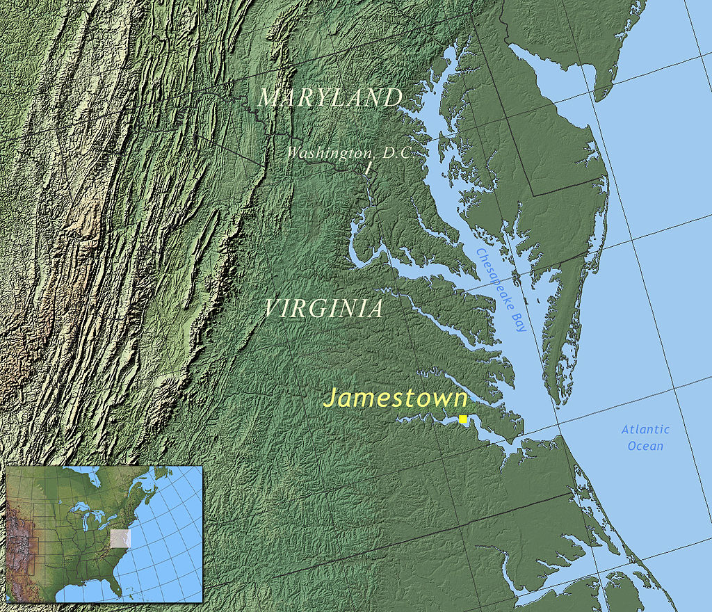
Jamestown
4

Slide 7
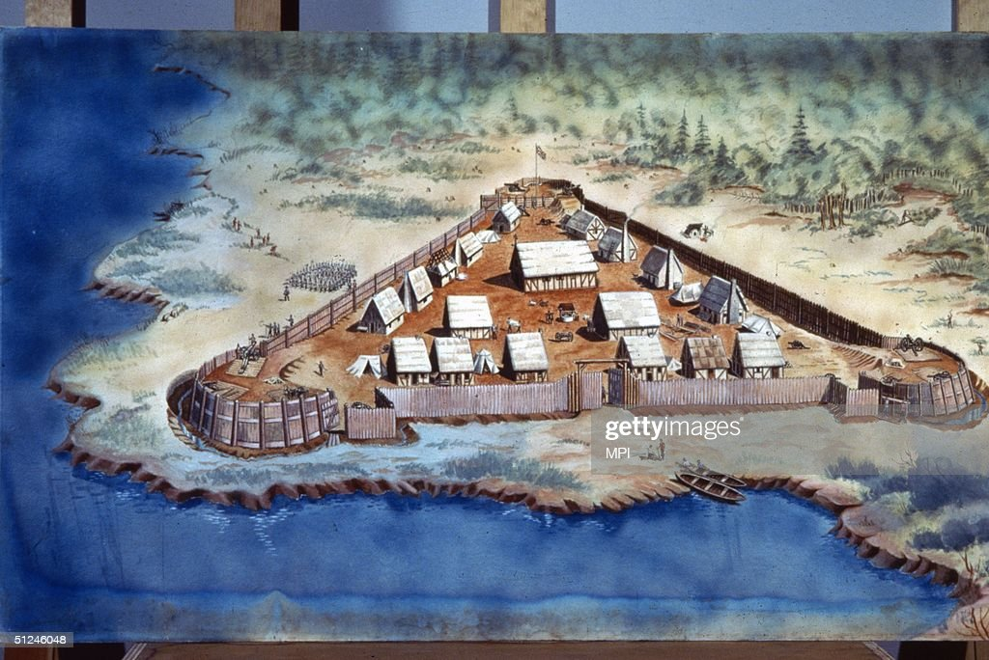
Jamestown 1608
5

Slide 8
Year One (1607/08 )
6
Captain Edward Wingfield, stockholder and first Governor,
Rats eat food, too late to plant, drought
A surplus of gentlemen
Indians hostile, settlers confined to stockade
70 out of first 100 settlers dead from disease and starvation

Slide 9
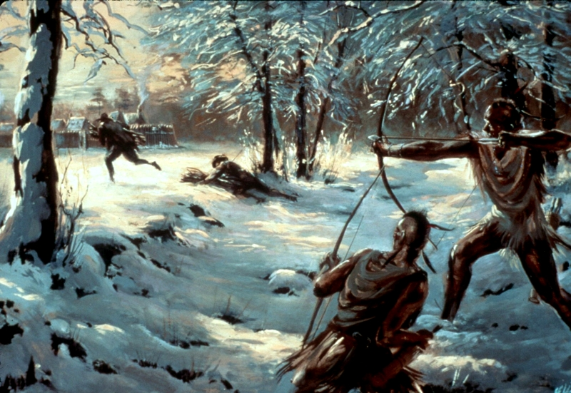
The trouble with foraging in a New World
7

Slide 10
Year Two Resupply and reorganise
8
Captain Newport returns 1608 with100 men and 2 women and demands for profit from stock holders
Wingfield removed and returns to England
John Smith new Governor, opens negotiations with Powahatan Indians and requires gentlemen to work

Slide 11
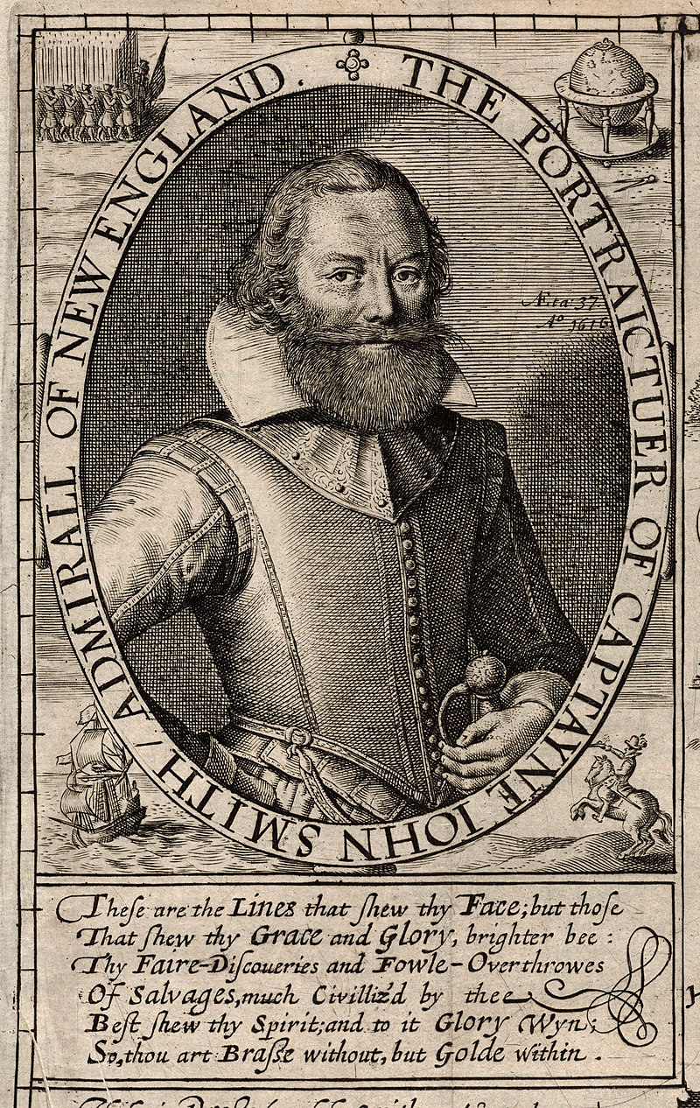
Captain John Smith
9

Slide 12
The new Regime
10
“You must obey this now for a law, that he that will not work shall not eat
(except by sickness he be disabled). For the labors of thirty or forty honest and
industrious men shall not be consumed to maintain a hundred and fifty idle
loiterers.”
“Women are more balanced than men. Where the most brilliant minds have so
far have mostly belonged to men, no women has ever been
as stupid as a man can be”.
The way forward: Work and Trade with the Indians…..

Slide 13
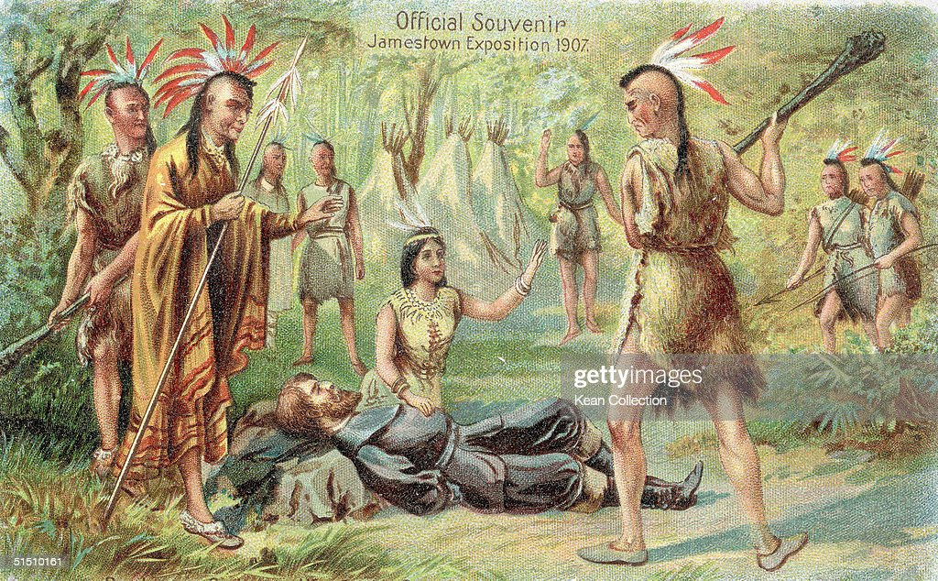
Pocahontas and Captain Smith
11
Tall Story? Indians claim John Smith being adopted, Pocahontas 13 years old and daughter of Powhatan Indian chief..

Slide 14
Year Three…a return to disaster
12
New arrivals…settlers increase to 500 including 150 soldiers
John Smith’s complaint: too many of wrong type of settler
Gunpowder accident, Smith returns,,to lobby for farmers, craftsmen, fewer ‘gentlemen’, more workers
New Governor, Thomas De L Marr and policy of conquest, builds forts and new settlements,
Indians cut off trade

Slide 15
The result: Starving Time 1609-10
13
500 settlers start of 1609….61 alive by spring 1610
And now, famine beginning to look ghastly and pale in every face…nothing was spared to maintain life and to do those things which seem incredible, as to dig up dead corpses out of graves and eat them, and some have licked up the blood which had fallen from their weak fellows. And amongst the rest, this was the most lamentable: that one of our colony murdered his wife, ripped the child out of her womb, and threw it into the river, and after, chopped the mother in pieces and salted her for food."
George Percy: A True Relation of the Proceedings and Occurrences of Moment which have happened in Virginia

Slide 16
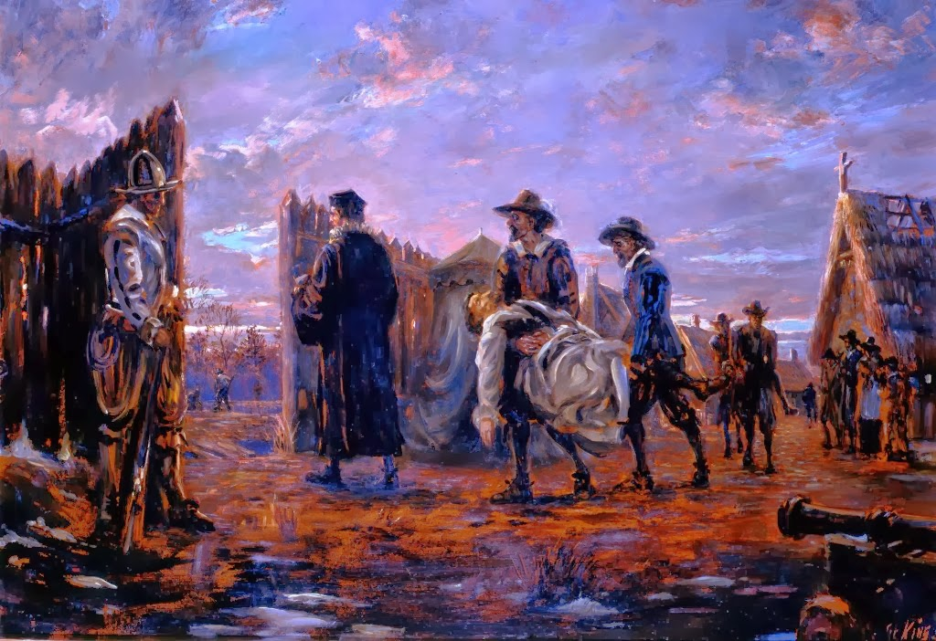
Jamestown 1609-10
14

Slide 17
Then war……
15
More settlers arrive.. Situation desperate
De La Warre negotiates ‘treaty’, sends 30 colonists to negotiate corn for food…Powhatan greet, entertain, then kill them all
English counterattack Indian camp, kill all men, kidnap women and children, pursued, drown children and hang women later…..
Four years of savage war… settler numbers rise due to new arrivals, Powhattan and small pox
‘Peace Treaty’…English seize hostages, including Pocahontas (now 19. She baptised as ‘Rebecca’ and well treated
I
Stalemate

Slide 18
John Rolfe, Pocahontas and Peace
16
John Rolfe, survivor from starvation and war, made ward of Pocohontas, wife dies” and writes letter to governor for permission to marry
“motivated not by the unbridled desire of carnal affection, but for the good of this plantation, for the honor of our country, for the Glory of God, for my own salvation... namely Pocahontas, to whom my hearty and best thoughts are, and have been a long time so entangled, and enthralled in so intricate a labyrinth that I was even a-wearied to unwind myself thereout.“
Governor agrees and there is Peace…for a while
Sends John and Pocahontas (now Rebecca) and son Thomas to England
Pocohantas minor celebrity
Meets King James, John Smith
Gossip on class/not race

Slide 19
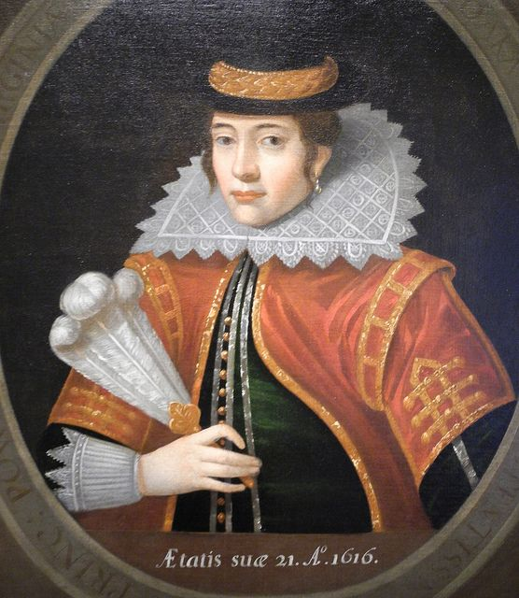
Pocahontas London 1616
17

Slide 20
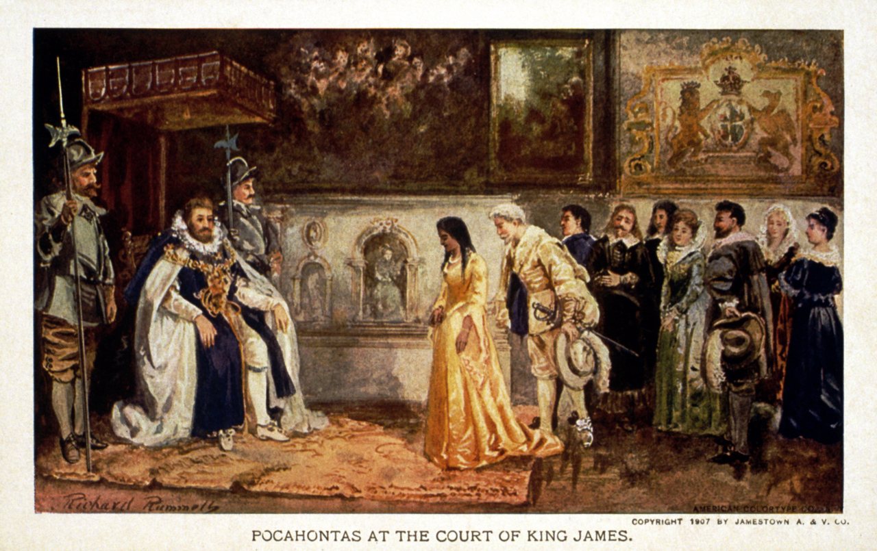
Pocahantas presented to King James
18

Slide 21
Pocahontas and her son: Thomas Rolfe
19
Actually not Pocohontas…Thomas too old.. Thi

Slide 22
Jamestown Continued
20
‘Long Peace of Pocahontas 1610-1620
Tobacco and a profitable colony
More arrivals….indentured servants, poles, germans, the first strike
)
Arrival of twenty ‘slaves’ (captured from Portugeese, Dutch ship, English captain
2,000 colonists by 1620

Slide 23
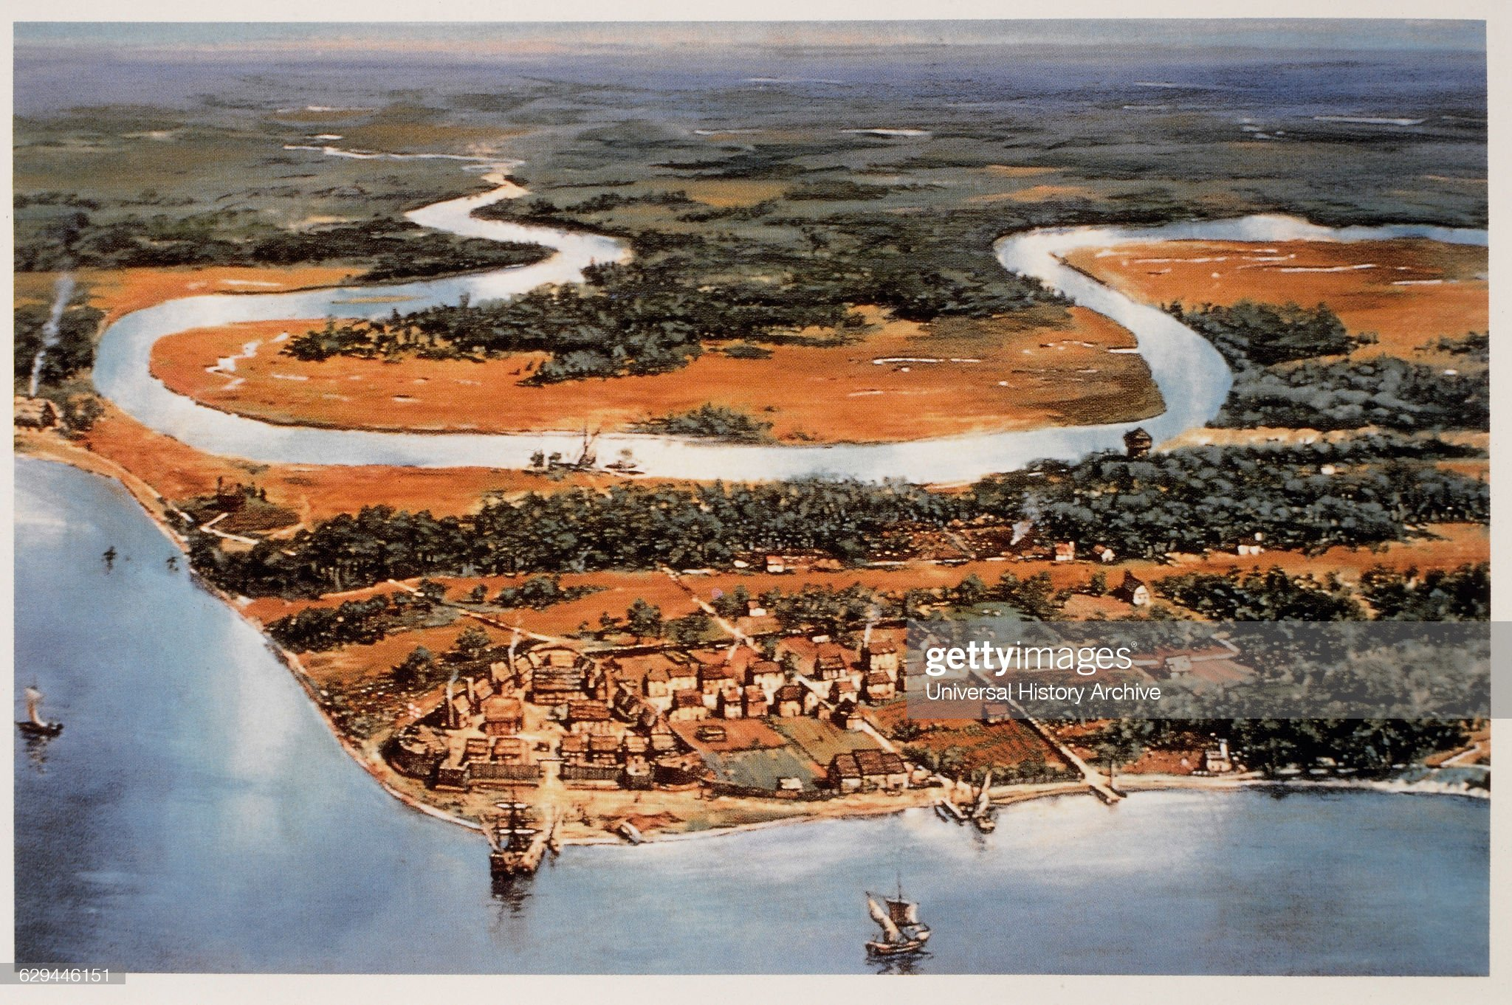
Jamestown Settlement 1620
21

Slide 24
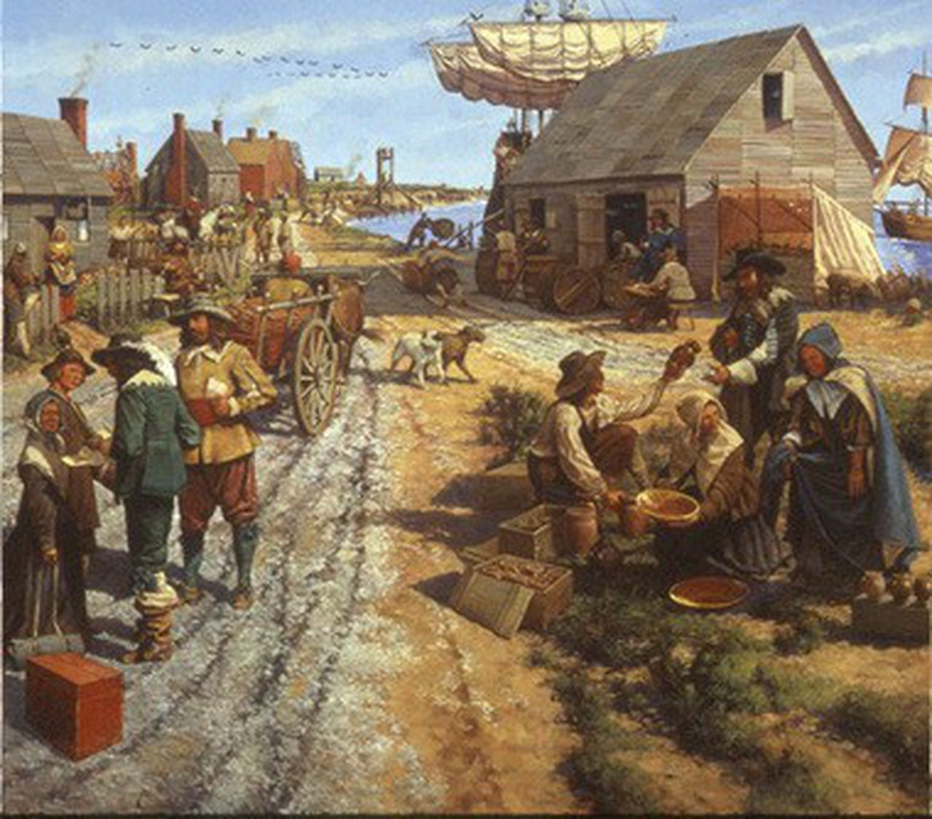
Jamestown 1607-1620
22

Slide 25
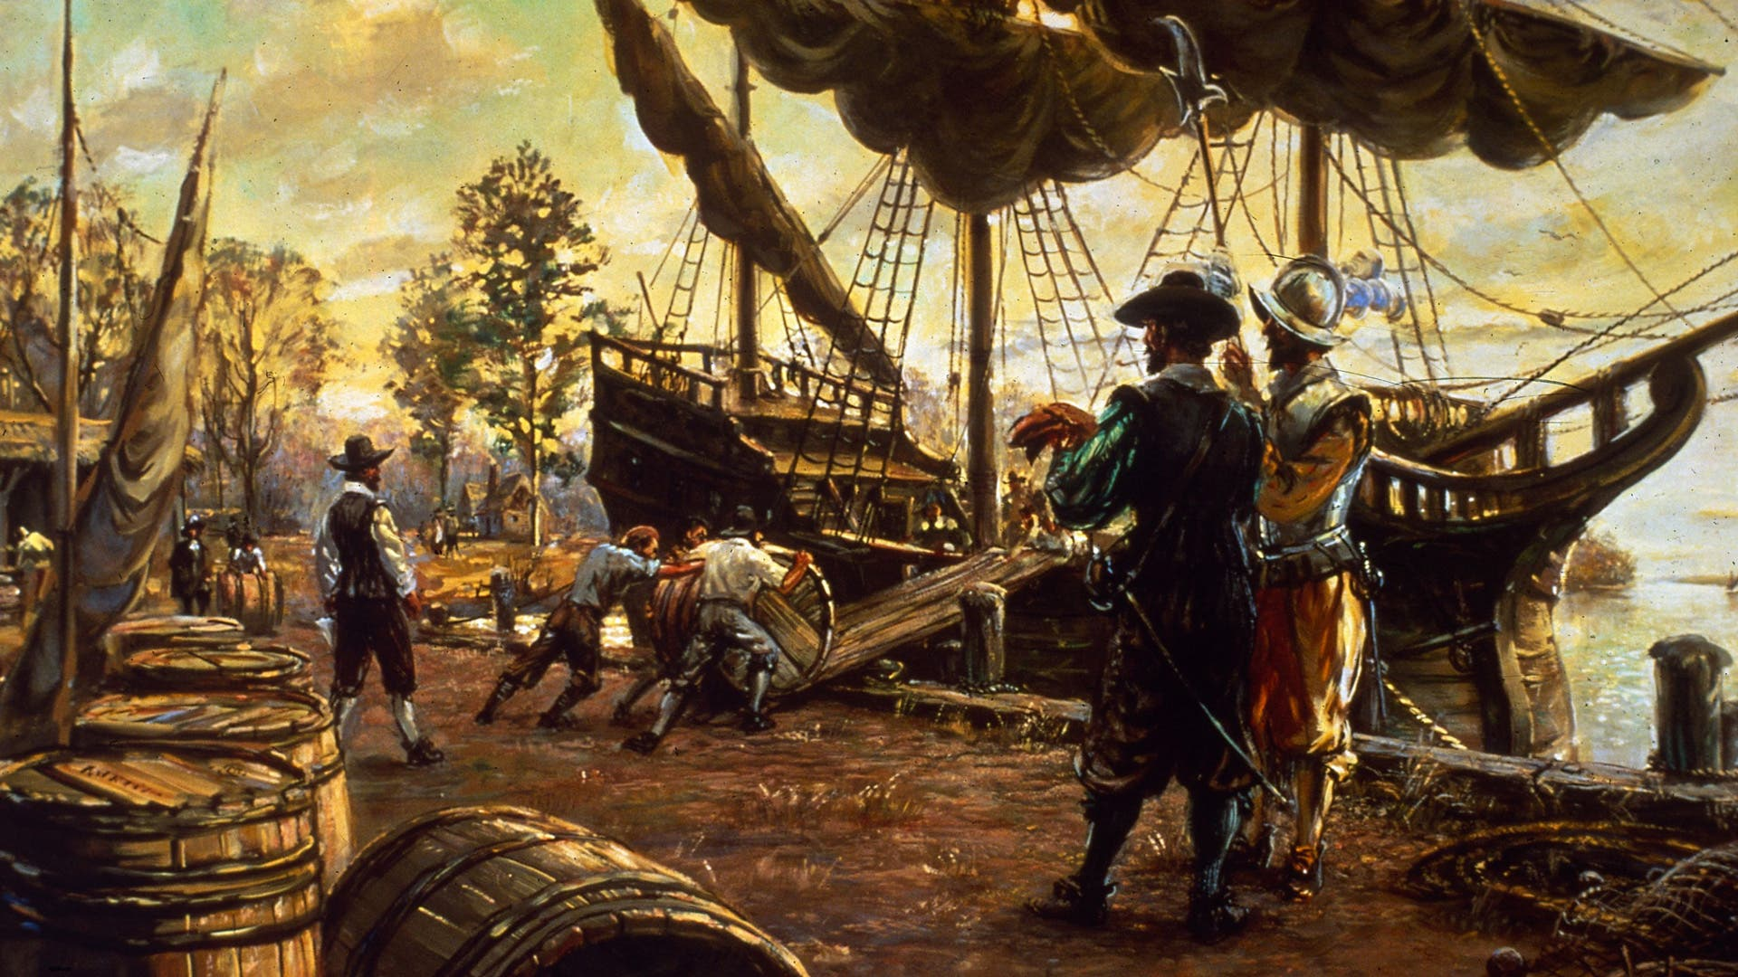
Exporting tobacco 1622
23

Slide 26
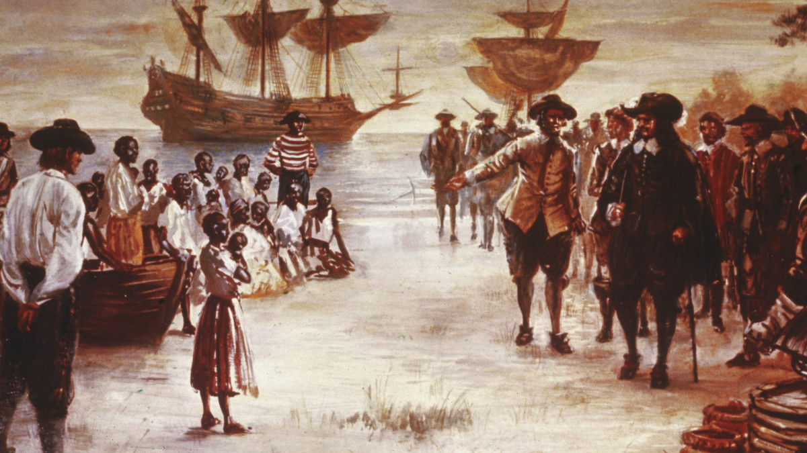
The first Africans 1619
24

Slide 27
Indian wars continued
25
Missionaries attempt to convert Indians…
‘Praying Indians’ …. Allies and indispensable
‘Non praying Indians’ …enemies to be destroyed
Powhatan chief threatened by new settlers and alliances with other tribes: resolves to end settlement pretends conversion, seeks to eliminate settlers
1622…Indians attack and one third setter population killed
A

Slide 28
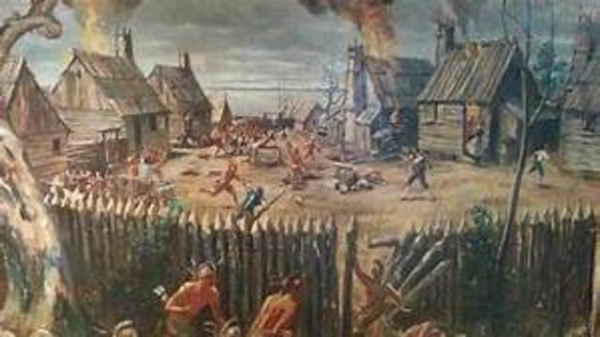
Second Powhatan War Indians attack on Jamestown
26

Slide 29
The Settlement Secured
27
Powhatan stops attacks. Waits for English to leave
English counteratttack….20 years intermittent and savage warfare
‘ Great Stockade’ 1634 a strong palisade… upon a straight between both rivers and… a sufficient force of men to defence of the same, whereby all the lower part of Virginia have a range for their cattle, near forty miles in length and in most places twelve miles (19 km) broad
Thomas Rolfe returns to New England 1640 , mediates with Indians
Colony population 20,000 by 1650
Indians reduced by disease and war to 2,000
Killings continue but colony secure

Slide 30
‘Mayflower’ and New England
28

Slide 31
Three colonies…three stories and cultures
29
Pennsylvania
1670
New England
1620
Jamestown…Virginia
108

Slide 32
The ‘Puritans’
30
Reformation…Calvinists early 1500’s
Anglican church created 1530
Seen as ‘too Catholic’
Reformers and Separatists (Pilgrims)same beliefs, different politics
Predestination: Jesus and ‘selective atonement’ salvation predetermined
The ‘Elect’ revealed by behaviour and appearance, sober, industrious and literate
‘Limited Atonement’…only the ‘godly’ to be saved
Ridiculed as ‘Puritan’: ( the joyless ones, “sticklers”)
Pilgrims Persecuted … fined for non attendance
Want “city upon a hill” where the ‘godly’ can prosper

Slide 33
Mayflower and Pilgrims 1620
31
Pilgrims: Nottingham ‘Separatists’ fined for non attendance, migrate to Holland in 1608, seek new uncontaminated world
Virginia Company desperate for profit seeks perfect settlers: Pilgrims
Mayflower, 120 colonists, 28 women, mix of 80 Pilgrims and 40 ‘Strangers led by Governor Bradford
Mayflower Contract….first constitution, rules and commitments and elections
Land Massachusetts November 1620
Notes:
About Pilgrims Separatists :Anglican church too Catholic by ritual and hierarchy, all decisions at churh
The elect pre chosen, revealed by clothes and manner
Democratic-(ish), literate, tenacious, industrious and well prepared …but not for winter
Intolerant of other beliefs and genocidically inclined
Sacraments: baptism and the Lord's Supper. Unconditional Election: As Calvinists, the Pilgrims believed that God predestined or chose who would go to heaven or hell before the creation of the worldey thought only the saved would engage in godly behavior. Hence, strict obedience to the law was demanded and hard work was required. Their religious practices and lifestyle were solely Bible-based. While the Anglican Church used a Book of Common Prayer, the Pilgrims read only from a psalm book, rejecting any prayers written by modern people.
Religious Holidays: The Pilgrims observed the commandment to "Remember the sabbath day, to keep it holy," (Exodus 20:8, KJV) yet they did not observe Christmas and Easter since they believed those religious holidays rk Idolatry: In their literal interpretation of the Bible, the Pilgrims rejected any church tradition or practice that did not have a Scripture verse to support it. They spurned crosses, statues, stained glass windows, e
James 1 Patent: “By God’s visitation, reigned a wonderful plague…“that had led to the utter Destruction, Devastacion, and Depopulation of that whole territory.”

Slide 34
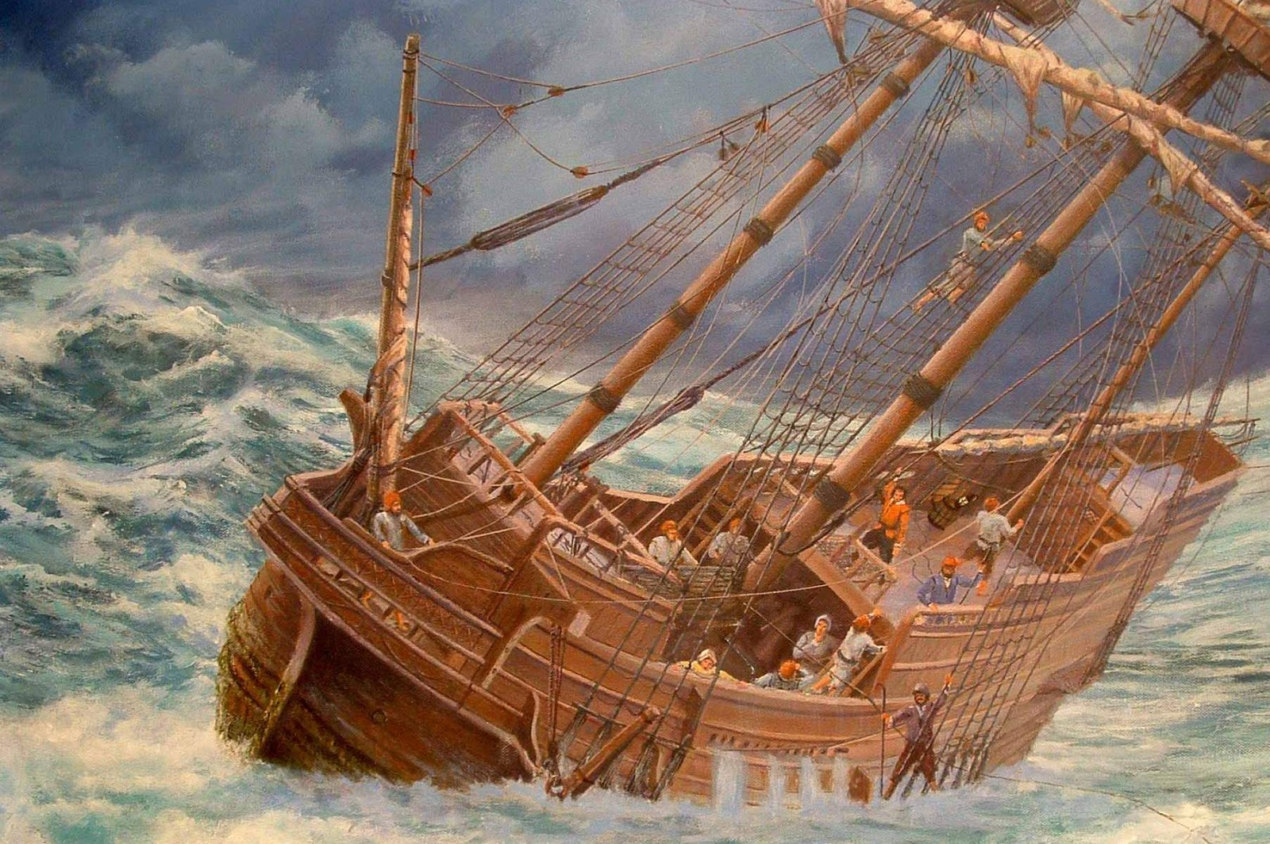
The Voyage
32
Notes:
Pilgrims fleeing economic persecution .
Plymouth faced many difficulties during its first winter, the most notable being the risk of starvation and the lack of suitable shelter. The Pilgrims had no way of knowing that the ground would be frozen by the middle of November, making it impossible to do any planting. Nor were they prepared for the snow storms that would make the countryside impassable without snowshoes. And in their haste to leave, they did not think to bring any fishing rods.^{[1]: 4}
⁷
From the beginning, the assistance they received from the local Native Americans was vital. One colonist's journal reported, "We dug and found some more corn, two or three baskets full, and a bag of beans. ... In all we had about ten bushels, which will be enough for seed. It is with God's help that we found this corn, for how else could we have done it, without meeting some Indians who might trouble us."^{[31]} Governor Bradford held out hope:
First T

Slide 35
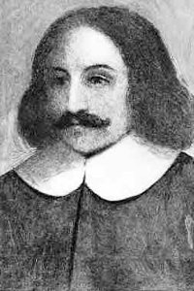
Governor Bradford
33

Slide 36
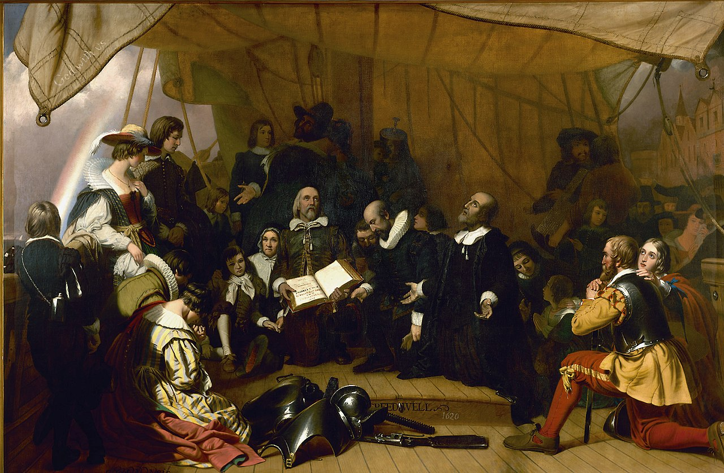
Maryflower Contract
34

Slide 37
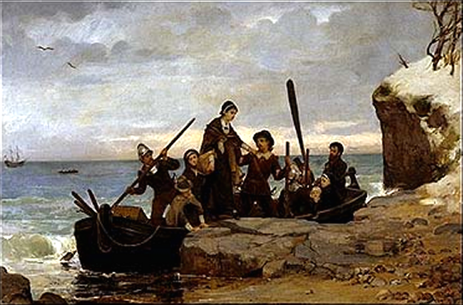
The arrival
35

Slide 38
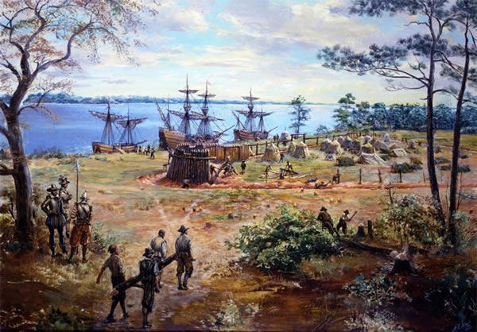
Building a Colony
35

Slide 39
Plymouth Colony Year One
36
Land empty: 90% of local Indians already succumbed to leptospirosis (rat fleas)…prior European contacts along coast
Winter brutal, unexpected
Men stay ashore, women and children returned to Mayflower
45 Colonist die from scurvy most abord first winter, Bradford’s wife and son
First crops appear to fail and all looks lost….
Enter Chief Massait of Algonquin Indians

Slide 40
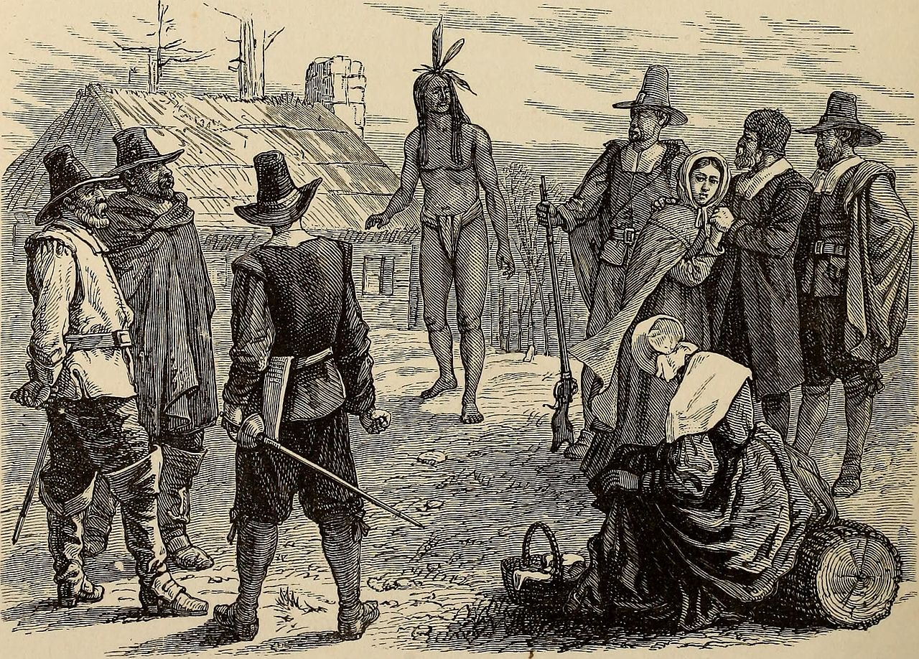
“Welcome Englishmen". Massasoit arrives
35
….to meets, strangers, asks for beer and alliance

Slide 41
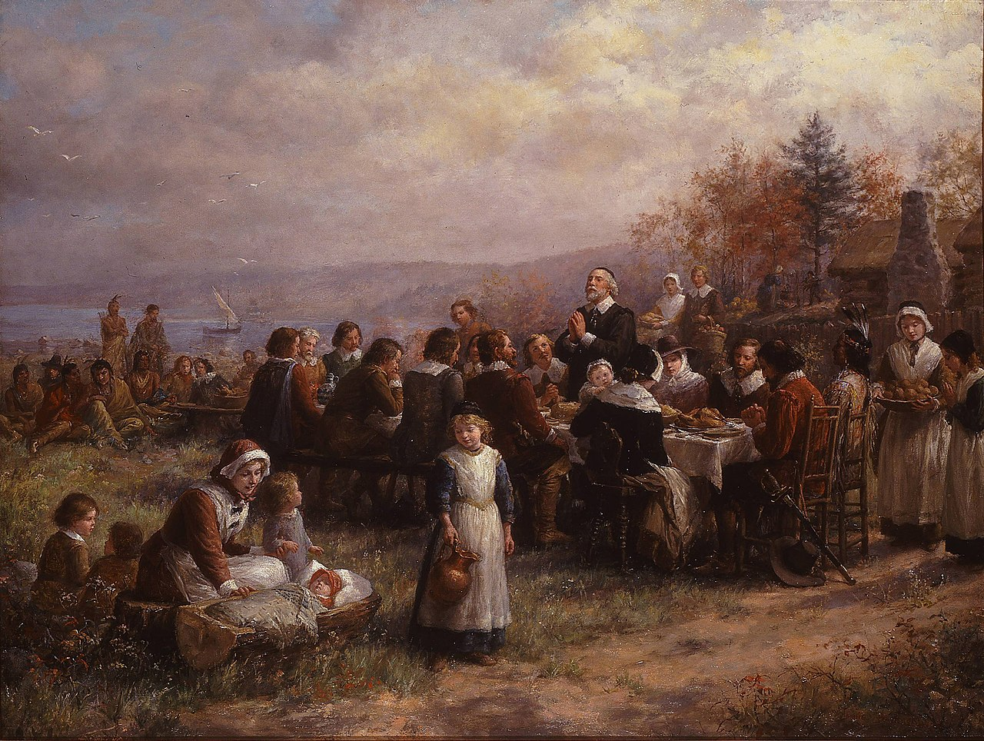
First Thanksgiving November 1621
36

Slide 42
The first Years
37
The ‘indispensable Indians’ and the ’Squanto’ factor’
New arrivals
A prosperous colony
Furs
Timber
Fish
Great Migration from England as Charles 1st attempts to supress ‘Puritans’ and news
Winthrop fleet arrives in 1630 with 1,000 settlers , new settlements

Slide 43
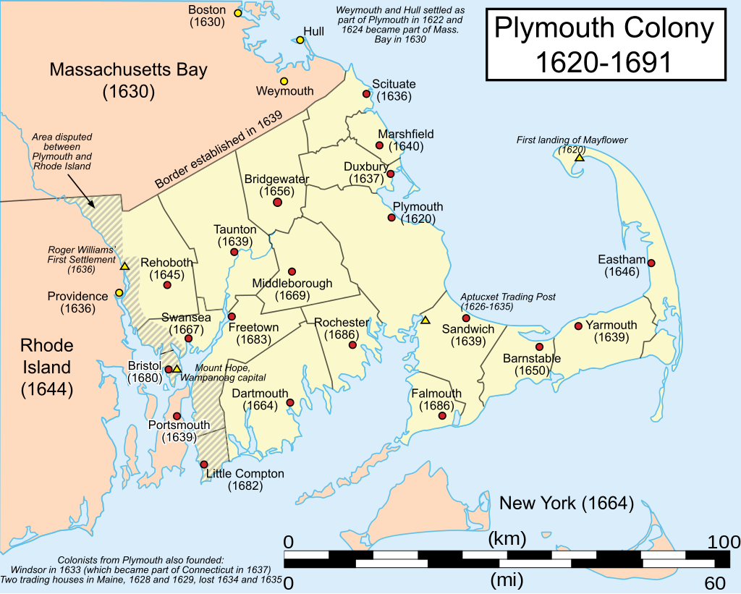
Massachusetts Colonies
38

Slide 44
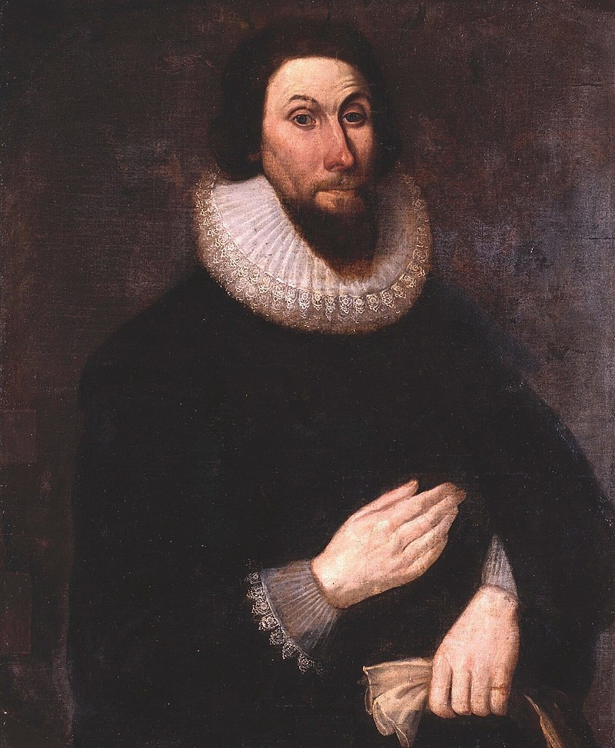
John Winthrop ( 1588-1649)
39
“In all times some must be rich some poore, some highe and eminent in power and dignitie; others meane and in subjection”

Slide 45
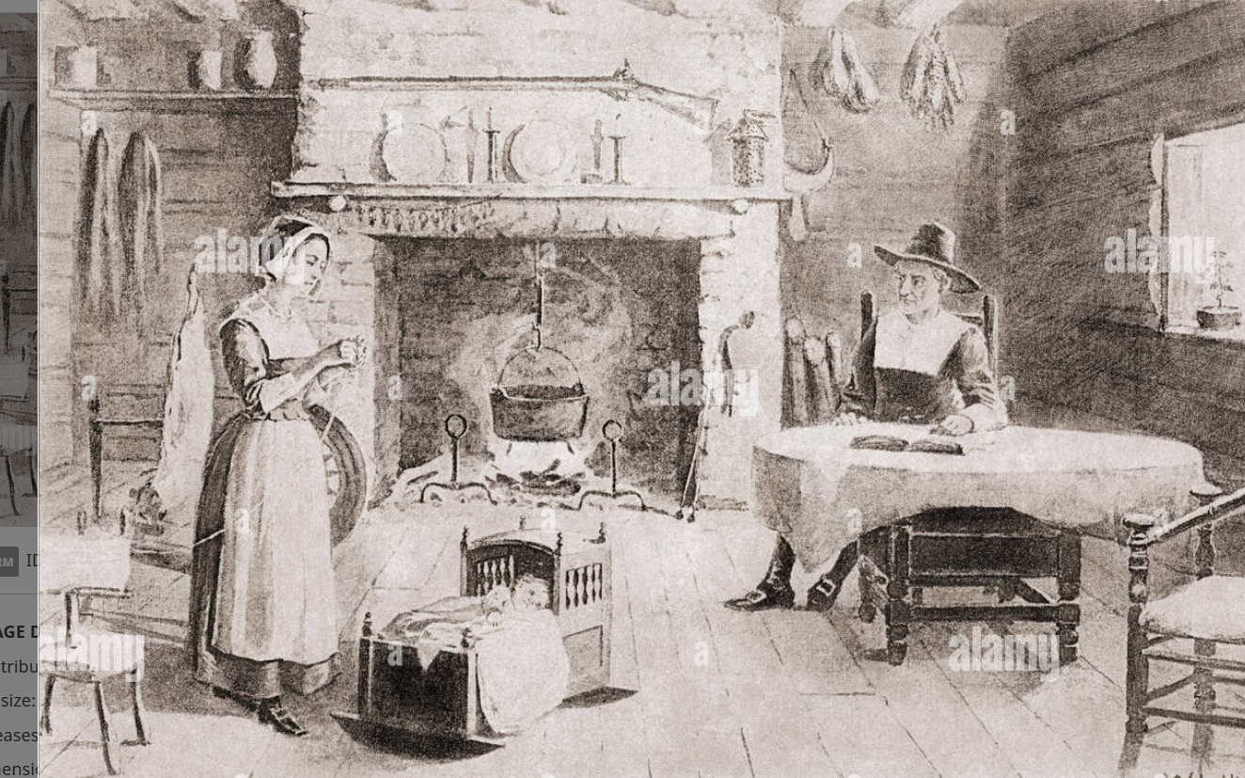
Puritan Life 1
40

Slide 46
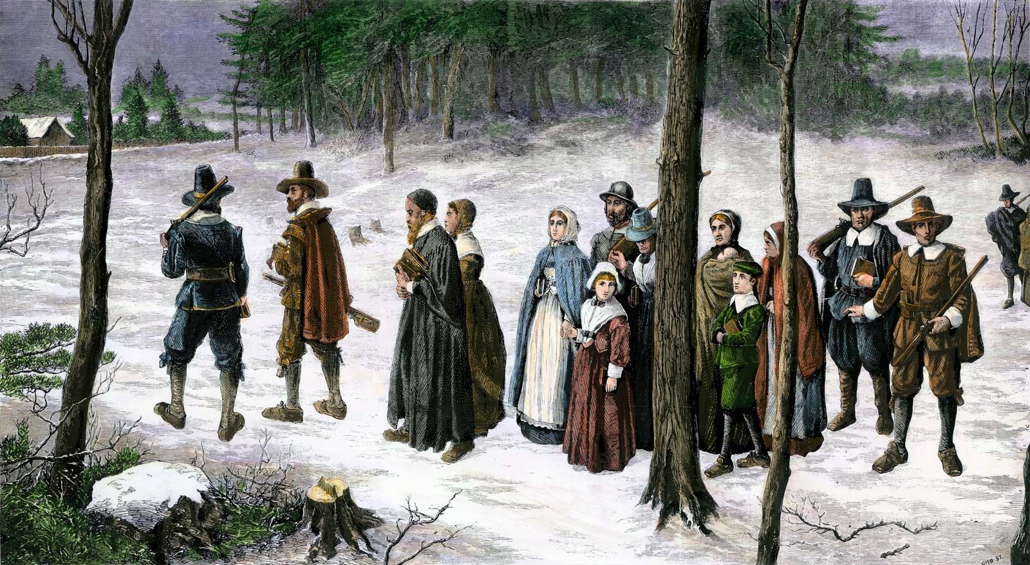
Puritan Life 2
41
41

Slide 47
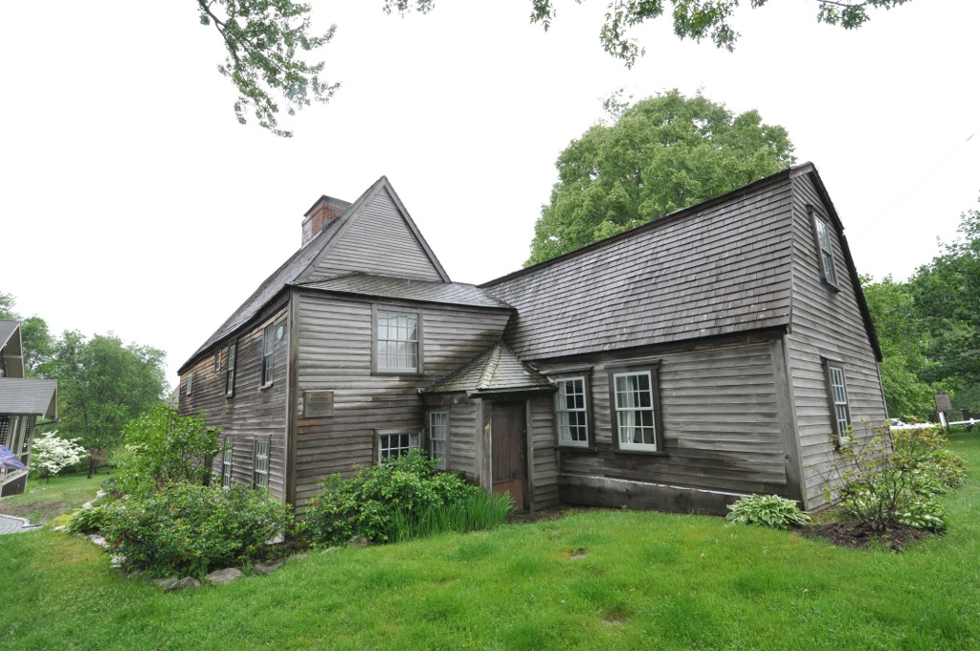
Puritan Home…built 1660
42

Slide 48
Puritan Culture 1620-70
43
Prosperous, industrious, Universal literacy…’dame schools’ for girls
Founding of first schools and colleges (Harvard 1635)
Orderly, single men adopted into homes, late marriages, zero illegitimacy, no crime, compulsory church attendance and absence of privacy
“Democracy” only for “Covenanted” church members only
Devil real and about deviations proof of his power and threat to the rule of the Godly and must be crushed

Slide 49
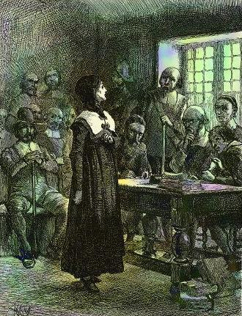
Anne Hutchinson Trial 1638
44

Slide 50
John Winthrop and Anne Hutchinson
50
The Court…charged her with diverse matters, as her keeping two public lectures every week in her house…and for reproaching most of the ministers (viz., all except Mr. Cotton) for not preaching a covenant of free grace, and that they had not the seal of the Spirit, nor were able ministers of the New Testament; which were clearly proved against her….And, after many speeches to and fro, at last she…vented her revelations; among which…that she had it revealed to her that she should come into New England, and should here be persecuted [presented], and that God would ruin us and our posterity, and the whole state, for the same. So the Court proceeded and banished her.
Anne and husband move to live in woods. has miscarriage and she and husband killed by Indians …..John Winthrop sees this as God’s verdict

Slide 51
New England Colony 1630’s -1660’s
45
Pequot War 1635.., ‘indispensable’ Indians ‘expendable’
Prosperity: lumber, glassware, fishing, and trade, Harvard founded 1635
Dissenter settlements …Rhode Island, Connecticut, New Jersey
‘Independent Province’ (1642-1660) till royal authority re-imposed
Absorbs Dutch colonies, New York, 65,000 settlers by 1670, thriving and spreading west

Slide 52
Intermission

Slide 53
The Pennsylvania Exception
46
About Quakers
Mid Atlantic (Pennsylvania/ Delaware)
Pennsylvania colony & the long peace

Slide 54
Emergence of Quakers
47
Origins in England 1640’s..George Fox
“Inner Light” in everyone and all can be saved
No sermons, ritual, belief in silent prepare and
Bible a guide to be studied but not only source
Non violence and toleration
Puritan response…threat to order and safety of community
Caning
Banishment or execution…Mary Dyer case

Slide 55
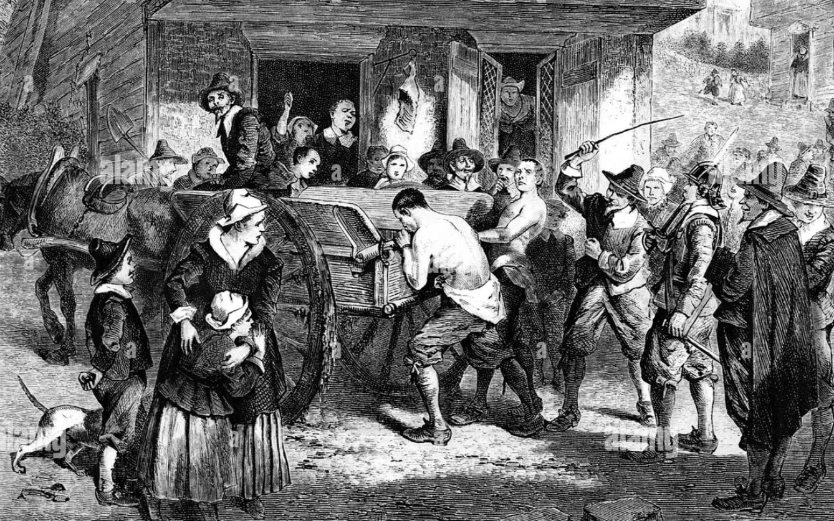
Caning of Quakers New England 1650’s
48

Slide 56
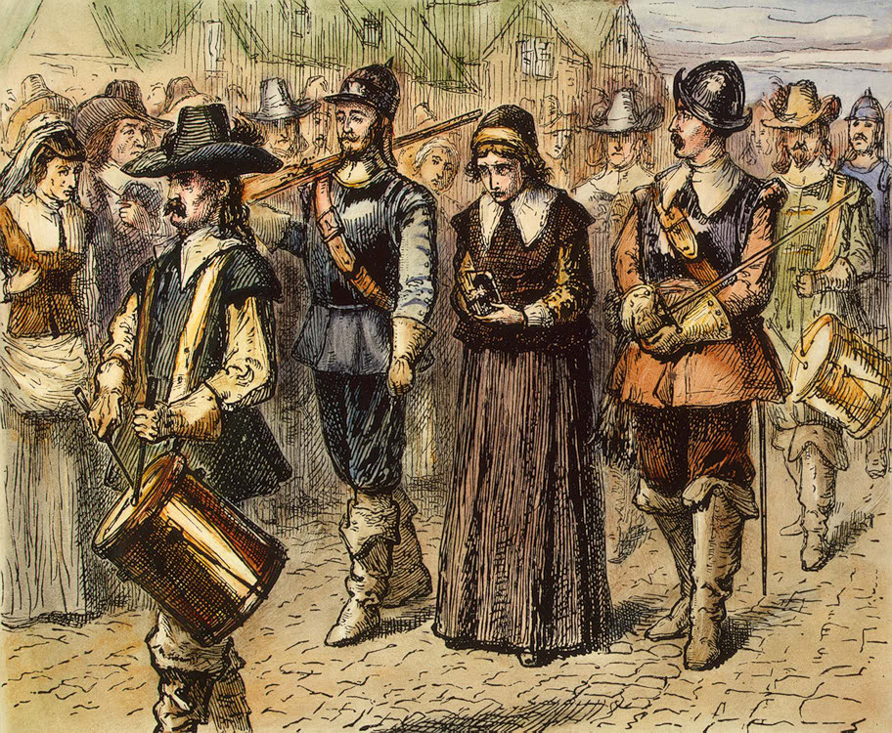
Quaker Mary Dyer on way to gallows 1660
49

Slide 57
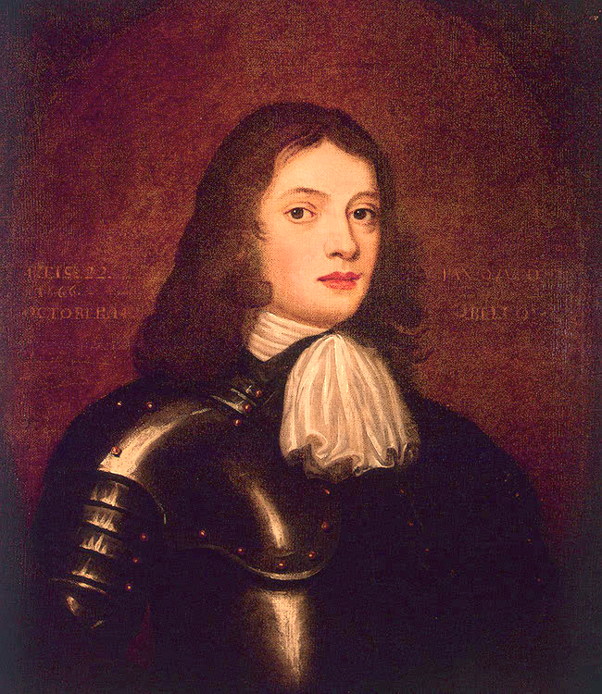
Young William Penn
51

Slide 58
Pennsylvania
52

Slide 59
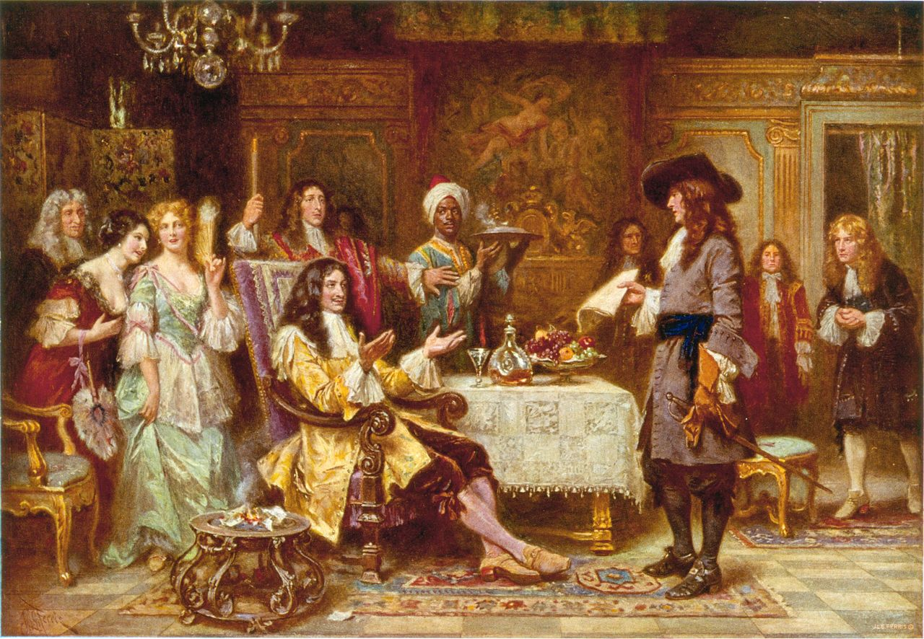
Making the deal 1680: King Charles exchanges debt to William Penn’s father for what will become Pennsylvania (named after William’s father
53
Notes:
About Quakers: George Fox and ‘Inner Light” persecuted since would not pay tithese or attend angican and breached ‘5 mile rule’ fines and imprisonment.
Religious movements during 1650;sSeekers, Ranters, Antinomians, Seventh Day Baptists, Soul sleepers, Adamites, Diggers, Levellers, Behmenists, Muggletonians
About William Penn:
Father admiral for Cromwelll. Given lands seized from Catholics in Ireland, switched side to support Charles 2nd. William born 1644, Dutch mother,
William student at Oxford, supports lecturer fired for Quaker beliefs, father sends to France …befriends Quakers, Holland returns announces Quaker, refuses to ‘swear’ allegiance to King father throws him out, lives among Quakers, fined, imprisoned, jury would not convict..jury fined 1 years wage sued court…and won…juries exempt from fines Father dies after reconcilied with son, Charles owes debt, Penn wants home for Quaekers and place for experiment agrees –45000 acres land….joins 2,000 settlers (other quakers here banished by NewEngland), commit to honest dealing, local Indians paid fair price and retained hunting rights, democratic tolerant of reigion but no behaviour, death penalty for treason and murder,no witches
Not happy ending for Indians or Penn
Walking Purchase …..Penns son.. The long run, Indians removed , fled
Penn…returns to England, debtors prision, rescued by public, dies in poverty.

Slide 60
Charles bidding Quakers farewell 1682
54

Slide 61
Penn’s Vision
55
‘Authoritarian liberal’, toleration, fair dealings with Indians
Education for all, care for mentally ill, death penalty for murder and treason only
Rationally planned cities ( Great Fire of London and Plague,,,city of brotherly love”
Colonies to be united within the Empire, separation of powers

Slide 62
The Treaty 1683
56

Slide 63
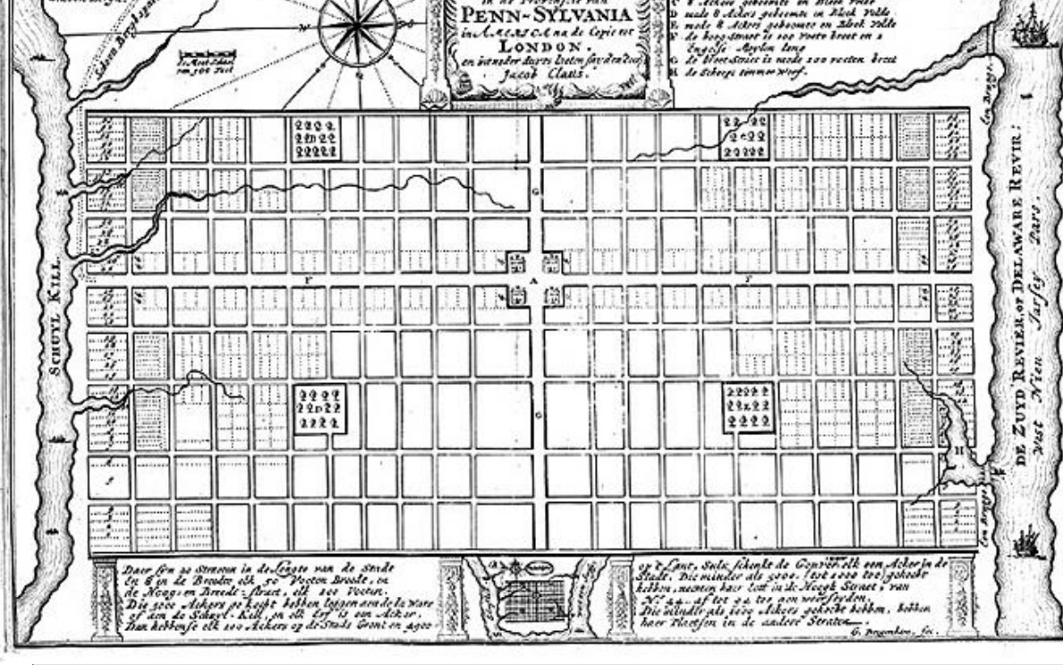
Street plan of Philadelphia 1683
57

Slide 64
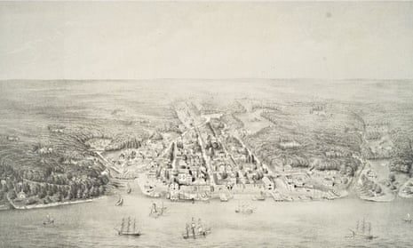
Philadelphia 1702
58

Slide 65
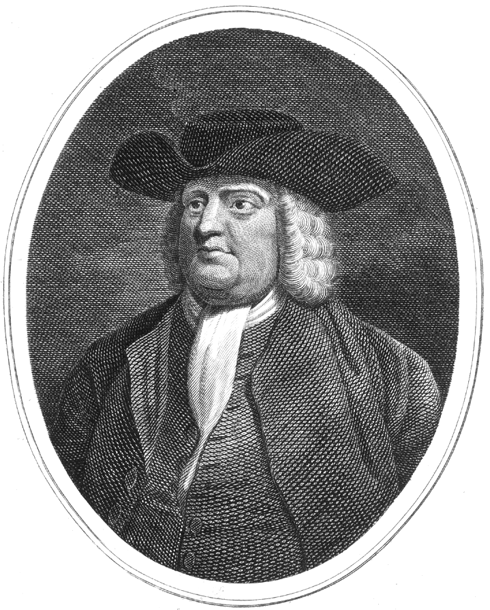
William Penn (1644-1720)
59
Humourless, Slave owner,
poor businessmen
rescued from debtor prison
by public
….dies in poverty 1720
Pennsylvania imperfect but most diverse and tolerant of colonies

Slide 66
….and back in Virginia
60

Slide 67
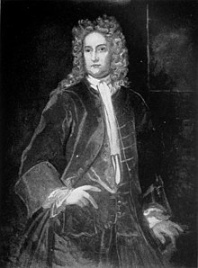
61
William Berkley (1605-77)
Governor of Virginia 1660-77

Slide 68
Berkeley and Virginia ( Governor 1660-1677)
62
aristocrat, reluctant tobacco cultivator, diversifies crops, imposes taxes to ‘improve colony’
Virginia to be autonomous Anglican province run by hierarchy…him and his friends
Opposed mass education fosters "disobedience, heresy, and sects into the world”
Regarding Indians… "I would have preserved those Indians that I knew were hoeurly at our mercy to have beene our spies and intelligence to find out the more bloudy Ennimies",.

Slide 69
Bacon’s Rebellion 1675/76
63
Berkley’s appoints Nathanial Bacon his nephew Lieutenant Governor
Bacon views uncle as corrupt and weak towards Indians
issues ‘Proclamation of the People”
Raises army of indentured servants, slaves, small planters
Moves on Jamestown, confronts Berkeley…’secures Commission in office”, leaves, returns to burn down Jamestown,

Slide 70
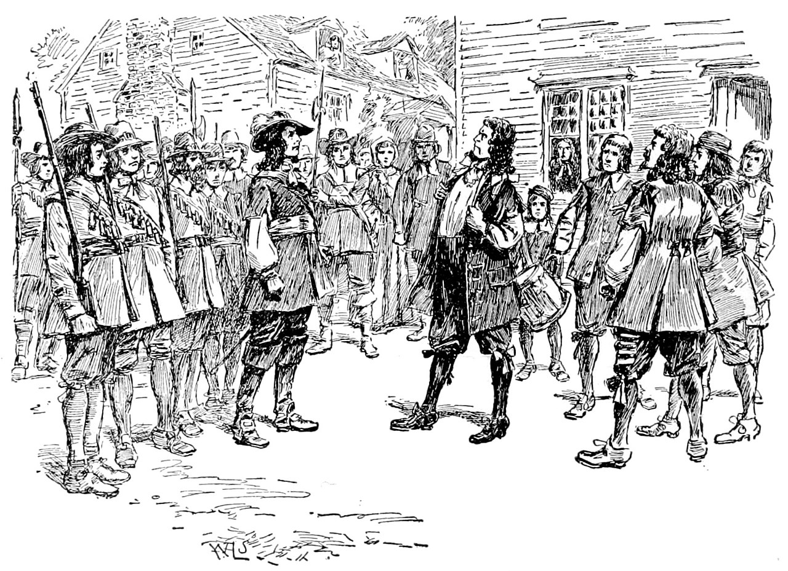
Bacon meets Governor Berkley
64

Slide 71
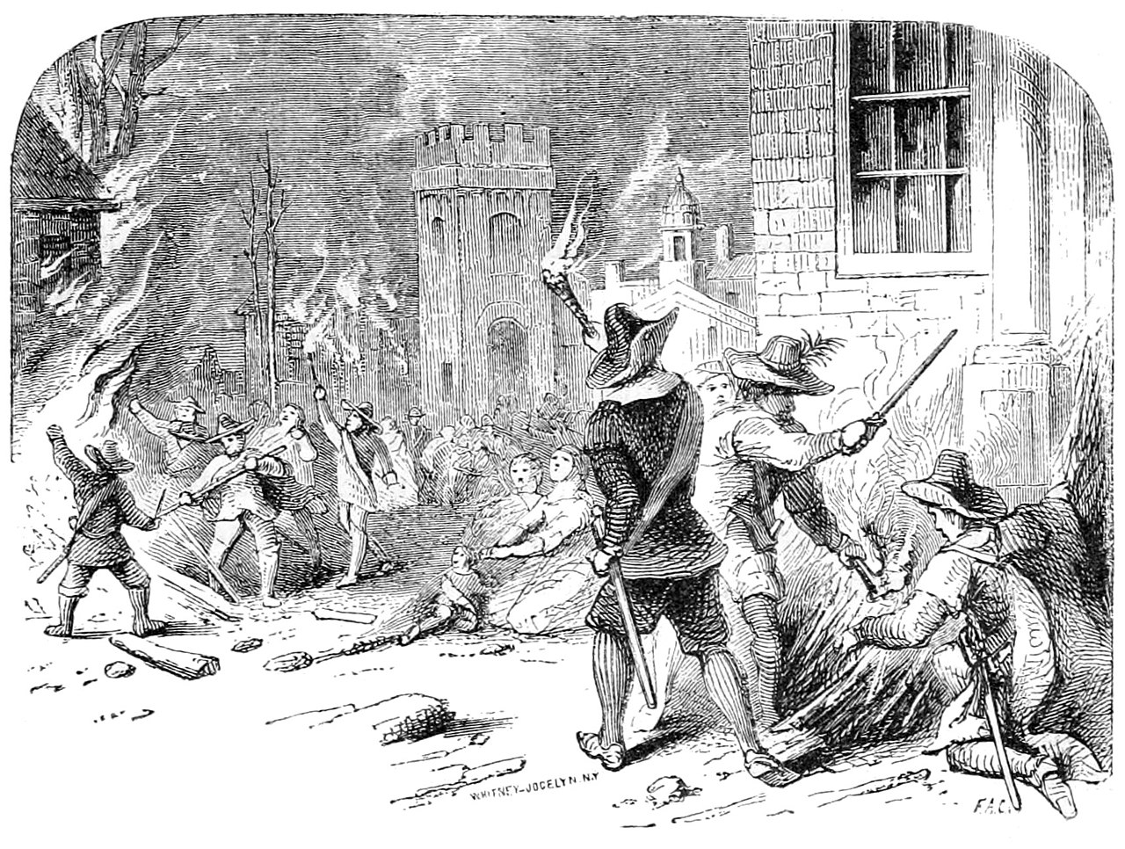
Burning of Jamestown
65

Slide 72
Virginia Colony by 1700
66
Bacon dies, Berkeley counterattacks and hangs leaders
Charles 2nd dismisses Berkeley to maintain order…overzealous
Jamestown abandoned and new capital built in Williamsburg
Laws codified: Slavery codified, white indentured servants disenfranchised
Colony thrives, population rises to 70,000, hierarchical society , plantation based economy, thriving tobacco, rice, and cotton

Slide 73
…meanwhile all is not well in New England
67
Political power shifting from Puritans to business men
Rising population (65,000 settlers vs estimated 10,000 Indians) and land seizures
Increased tribal warfare., competition for western goods, firs running out, ongoing diseases, tension preying versus non preying” Indians,
War breaks out 1675

Slide 74
King Phillips War 1675-77
68
‘Preying Indian’, John Sassamon warns English of pending attack, murdered, trial and three Indians hanged (mixed jury !)
Indians retaliate massacring settlers
Settlers attack Indian camp seize food, ambushed ‘Bloody Brook”
Counterattack and capture Indian amp at ‘Battle of “Great Swamp”, 600 Indians killed, and 100 settlers, wives children sold to slaver
War continues two years… settlers win..

Slide 75
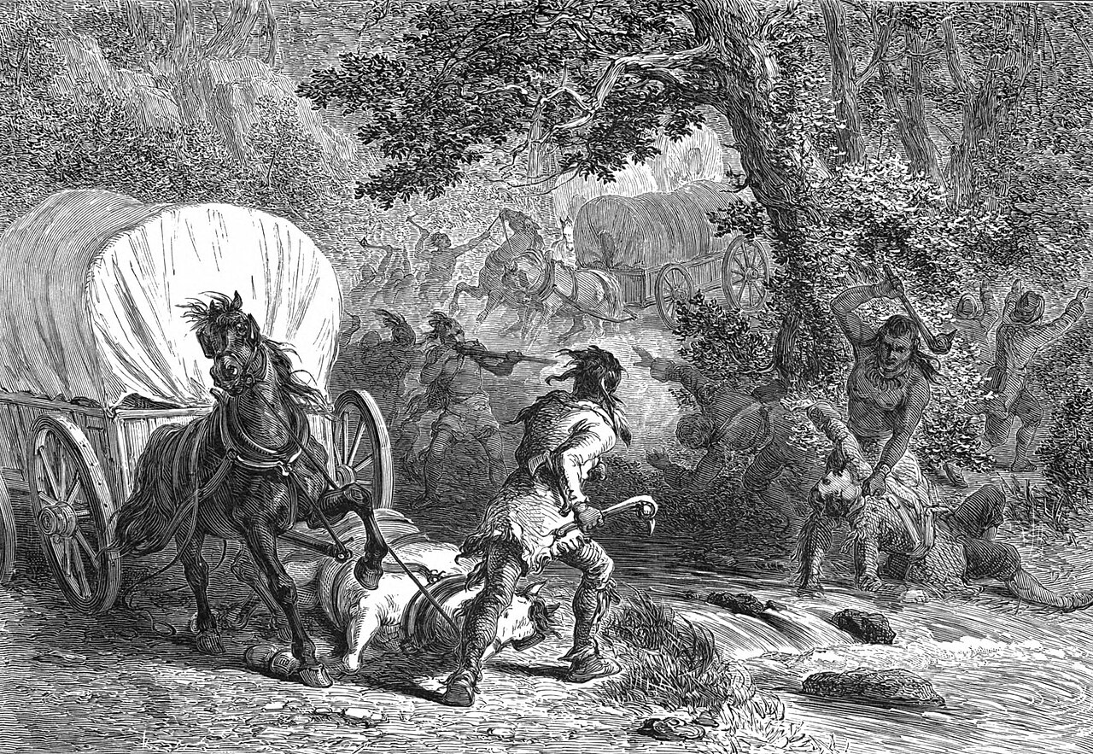
Battle of Bloody Brook
69

Slide 76
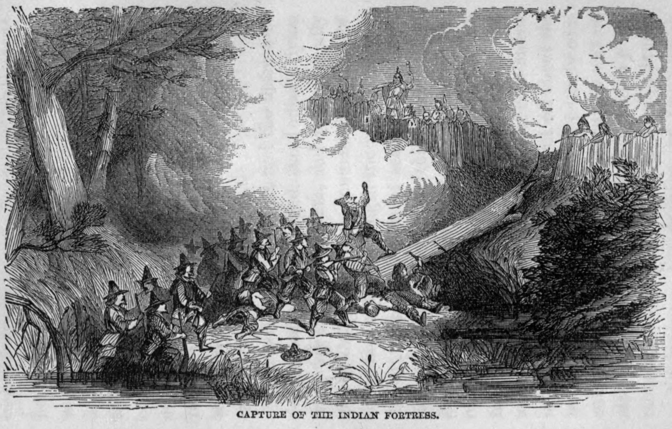
Battle of the Great Swamp 1675
70

Slide 77
Aftermath of King Phillips War
71
10% males killed, 20% settlements destroyed or damaged
Killings continue but Indians no longer threat to colonies existence
Threat to colonies now France, Spain
and the “enemy within”…
Notes:
Brief history
No witch trials in medieval Europe….tolerance of the “wise woman” and use of herbs as medicines. Considered ‘pagan superstition” Inquisiton papal

Slide 78
A brief history of Witch Mania
72
“cunning women” tolerated ancient to medieval times
200,000 witches (80% women) burned Europe 1500-1700
10,000 trials in England and Scotland, 2,500 hanged 1560-1700
James V1 of Scotland, 1st of England writes manual…Puritans study
Witch trials “Waves”…not continuous…triggered by stress

Slide 79
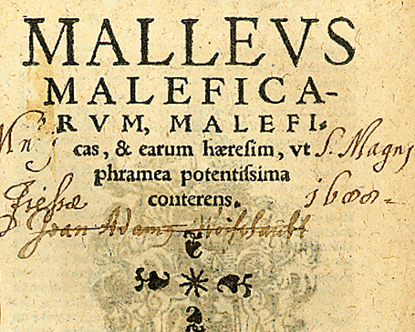
Standard Witch detection text book
73

Slide 80
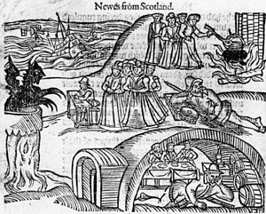
Imagined life of witches
74

Slide 81
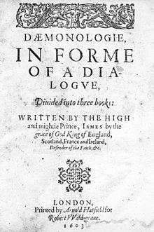
King James’s Manual
75

Slide 82
Salem Massachussets 1692
76
Loss of political power to New England Government
Change in pastor
Cotton Mather’s best seller
Family feuds, hysterical children aged 9 and11, available single elderly women
Admission of ‘spectral evidence’.

Slide 83
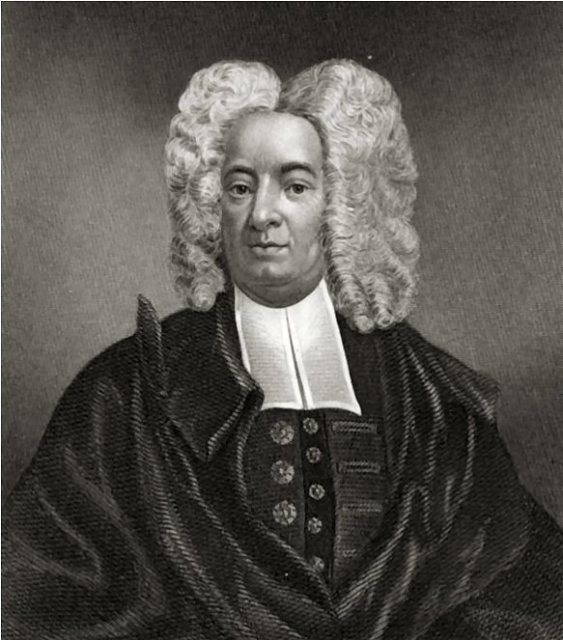
Cotton Mather Memorable Providences Relating to Witchcrafts and Possessions (1689)
77

Slide 84
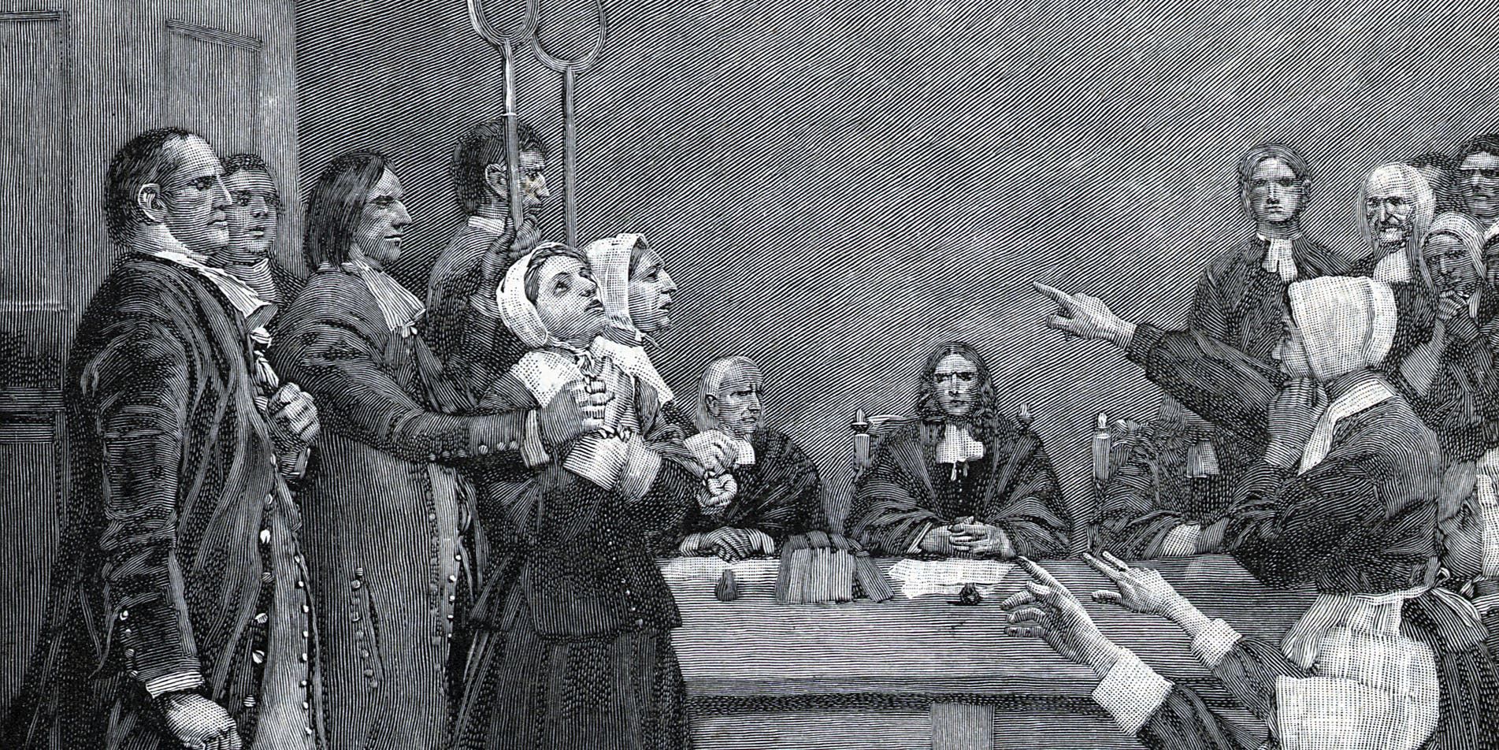
A Trial
78

Slide 85
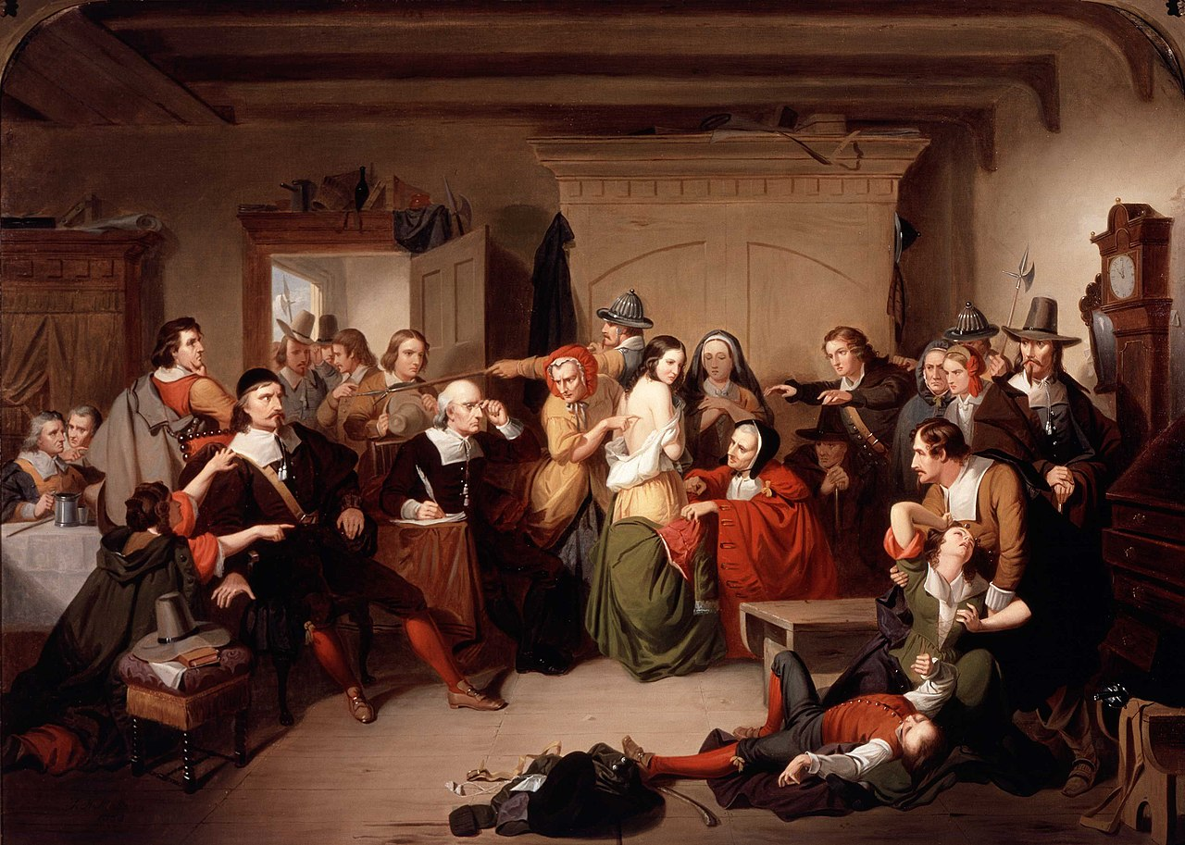
Examination of a witch
79

Slide 86
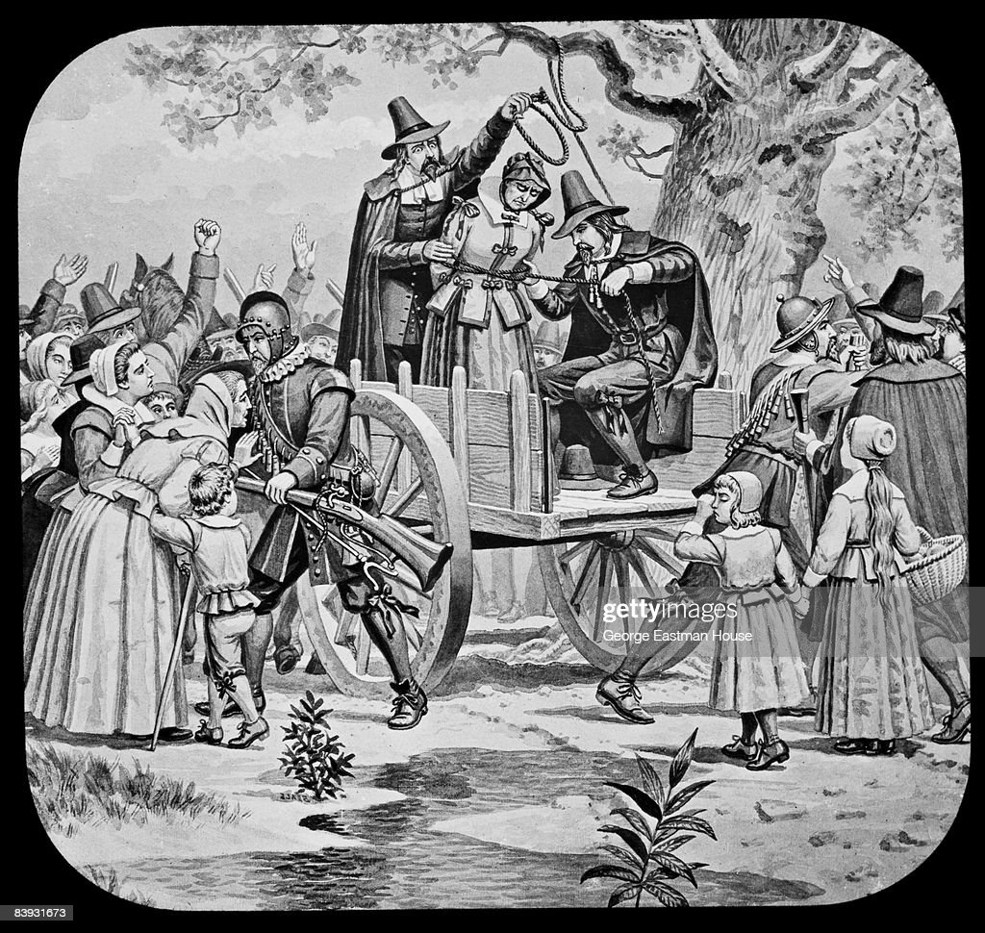
Execution of Bridgit Bridges
80

Slide 87
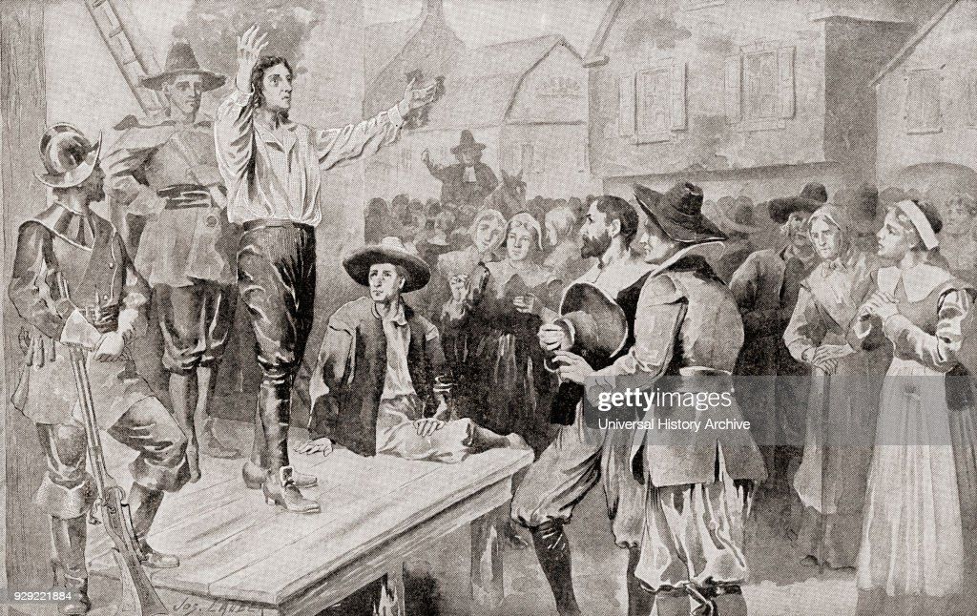
George Burroughs recites Lords Prayer…not thought to be possible!
81

Slide 88
Aftermath
Judges in New England doubt their verdicts…Cotton Matthew tries to supress opposition, but families pursue case…
200 people accused of witchcraft in North America, 50 executed…all in New England
Last of its kind in English speaking world
Quaker publishes expose of trials published in London
Governor awards compensation to victims, Witch Act suspended

Slide 89
State of the British Colonies 1700
Settler population rising rapidly
year | Population | Growth rate
1610 | 350 | N/A
1620 | 2,302 | 557.71%
1630 | 4,646 | 101.82%
1640 | 26,634 | 473.27%
1650 | 50,368 | 89.11%
1660 | 75,058 | 49.02%
1670 | 111,935 | 49.13%
1680 | 151,507 | 34.35%
1690 | 210,372 | 38.85%
1700 | 250,888 | 19.26%
Indigenous population declining rapidly (from estimated 1-2 million1600 to 250,000 by 1700
25,000 slaves almost all in southern and mid Atlantic states
British America secure

